Slide 1

Data Driven Applications
Web Applications
Introduction to PHP II
PHP Functions and HTML/PHP Forms
Web Apps – L05

Slide 2
Learning Outcomes
You will be able to describe and use the following PHP scripting features
PHP user defined functions
PHP superglobal functions and variables
HTML/PHP forms

Slide 3
Setup
Make sure your Apache server is running – check your XAMPP control panel
In your htdocs folder make sure there is a subfolder for this topic
Eg ..C:/xampp/htdocs/K00999999/T01
Download and unzip the code for this lecture to this folder
Start NETBEANS
Open the L04 project at this location

Slide 4
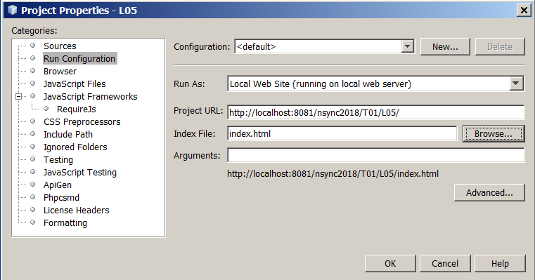
Configure NETBEANS project Properties
Right click on the project, select PROPERTIES/RUN CONFIGURATION
Set the PROJECT URL and index file to the correct one for your setup

Slide 5
PHP Functions
2 Types of Function in PHP
User defined functions
Built-in Functions – there are over 1000 built-in functions in PHP

Slide 6
User Defined Functions
A user defined function declaration starts with the word "function":
<?php
function writeMsg1() {
echo "Hello world!<br>";
}
writeMsg1(); // call the function
?>

Slide 7
Function Arguments
A function MUST be declared before it is called.
Functions , when defined, have a global scope
Information may be passed to functions via the argument list, which is a comma-delimited list of expressions. The arguments are evaluated from left to right.
A user defined function declaration starts with the word "function":
<?php
function writeMsg2() {
echo "Hello world!";
}
$myMessage=
writeMsg(); // call the function
?>

Slide 8
Return a value
Functions may provide any kind of return value
<?php
function sum($x, $y) {
$z = $x + $y;
return $z;
}?>
PHP_Functions.php
Notes:
<html>
<head>
<title>PHP_functions</title>
</head>
<body>
<h1>Functions</h1>
<?php
//define the functions
function writeMsg1() {
echo "The message is:Hello World <br>";
}
function writeMsg2($msg) {
echo "The message is: $msg<br>";
}
function sum($x, $y) {
$z = $x + $y;
return $z;
}
//define some variables:
$myMessage="Welcome to Data Driven Applications";
$var1=10;
$var2=15;
//call the functions
writeMsg1();
writeMsg2($myMessage); // call the function
echo "The sum of $var1 and $var2 is = sum($var1,$var2) <br>"; //a function cannot be evaluated inside a double-quoted string!!
echo "The sum of $var1 and $var2 is = ".sum($var1,$var2); //but this works
?>
</body>
</html>

Slide 9
Returning Values from Functions
Applications are usually a sequence of functions.
The result from one function is then passed to another function for processing and so on.
Returning a value from a function is done by using the return statement.
PHP_functions_return_values.php
Notes:
<html>
<head>
<title>PHP_functions_return_values</title>
</head>
<body>
<h1>Functions Returning Values</h1>
<h2>Table of Important Web Programming Technologies</h2>
<p>
<?php
//define functions:
function buildRows($array)
{ //generates a string of html containing the row data and table row element tags
$rows = '<tr><td>' .
implode('</td></tr><tr><td>', $array) .
'</td></tr>'; //note the use of the implode function
return $rows; //returns a string
}
function buildTable($rows)
{ //adds the table element tags to the rows
$table = "<table cellpadding='1' cellspacing='1' bgcolor='#FFCC00' border='1'>$rows</table>";
return $table;
}
//create an array to display in the table
$myarray = array('php',
'mysql',
'apache',
'java',
'xml');
//call the functions to create the table
echo buildTable(buildRows($myarray));
?>
</p>
</body>
</html>

Slide 10
Using Forms
Using forms in a web based application is very common.
Most forms are used to gather information like in a signup form, survey / polling, guestbook, etc.
A form can have the method set as post or get.
When using a form with method="post" you can use $_POST array to access the form values.
And when the form is using method="get" you can use $_GET array to access the values.
The $_REQUEST superglobal can be used to access form values with method="post" and method="get" but it is recommended to use $_POST or $_GET instead so you will know from what method did the values come from.

Slide 11
Simple Form Example
This simple form illustrates how the form method is specified and which script subsequently processes the form data.
The form also specifies the variable names that will be used in the $_POST array
<h1>Form 1</h1>
<form action="PHP_form1_processing.php" method="post">
Enter a value: <input type="text" name="value1"><br>
Enter a value: <input type="text" name="value2"><br>
<input type="submit" name="data_submitted">
</form>
PHP_form1.php
Notes:
<html>
<head>
<title>PHP_form1</title>
</head>
<body>
<h1>Form 1</h1>
<p>This simple example shows how user data may be entered in a form and processed by a separate script.
</p>
<form action="PHP_form1_processing.php" method="post">
Enter a value: <input type="text" name="value1"><br>
Enter a value: <input type="text" name="value2"><br>
<input type="submit" type="button" value="Get Sum" name="data_submitted">
</form>
</body>
</html>

Slide 12
Form Processing
When the submit button is pressed the $_POST array will be populated with 3 values from the form
$_POST['data_submitted'] – BOOLEAN 1 (‘Get Sum’) or 0 (empty)
$_POST['value1'] – first form field string/numeric
$_POST['value2'] – second form field string/numeric
$_POST['data_submitted'] may be used to determine if the submit button has been pressed. If the button is pressed the value=“Get Sum” is inserted into $_POST['data_submitted']
PHP_form1_processing.php
Notes:
<html>
<head>
<title>PHP_form1_processing</title>
</head>
<body>
<h1>Form 1 Processing</h1>
<?php
//define the functions
function sum($x, $y) {
$z = $x + $y;
return $z;
}
?>
<?php
if (isset($_POST['data_submitted'])){ //check that the form has been submitted
echo 'The SUM of '.$_POST['value1'];
echo ' and '.$_POST['value2'];
echo ' is = '.sum($_POST['value1'],$_POST['value2']); //call the function
}
else //the form has not been submitted
{
echo "<p>Please enter some values in the form.</p>";
echo "<a href=PHP_form1.php>Go back</a>";
}
?>
</body>
</html>

Slide 13
Form Self Processing
Its common practice to put the script that processes a form in the same script page as the form itself.
$_SERVER["PHP_SELF"] is a PHP server reserved variable - The filename of the currently executing script, relative to the document root.
PHP_form2_self_processing.php
Notes:
<html>
<head>
<title>PHP_form2_self_processing</title>
</head>
<body>
<h1>Form 2 Self Processing</h1>
<form action="<?php echo $_SERVER["PHP_SELF"];?>" method="post">
Enter a value: <input type="text" name="value1"><br>
Enter a value: <input type="text" name="value2"><br>
<input type="submit" type="button" value="Get Sum" name="data_submitted">
</form>
<hr>
<?php
//define the functions
function sum($x, $y) {
$z = $x + $y;
return $z;
}
?>
<?php
echo '$_SERVER["PHP_SELF"] ='.$_SERVER["PHP_SELF"].'</br></br>';
if (isset($_POST['data_submitted'])){ //check that the form has been submitted
echo 'The SUM of '.$_POST['value1'];
echo ' and '.$_POST['value2'];
echo ' is = '.sum($_POST['value1'],$_POST['value2']);
}
else //the form has not been submitted
{
echo "Please enter some values in the form.";
}
?>
</body>
</html>

Slide 14
Exercise
Create a simple form based web application to accept two numbers.
The form should have two fields for the numbers and three buttons.
The buttons are to be labelled ADD, SUBTRACT and TABLE

Slide 15
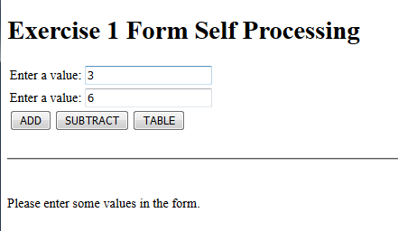
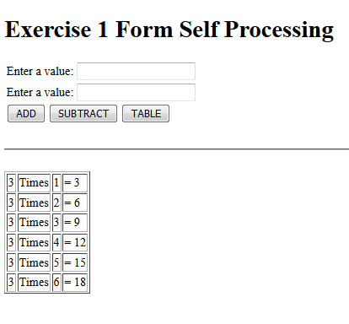
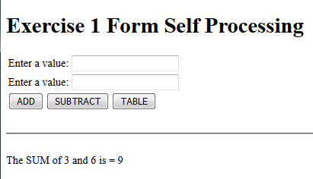

Slide 16
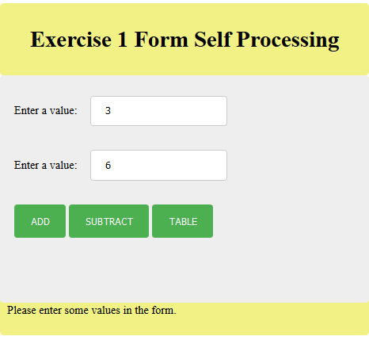
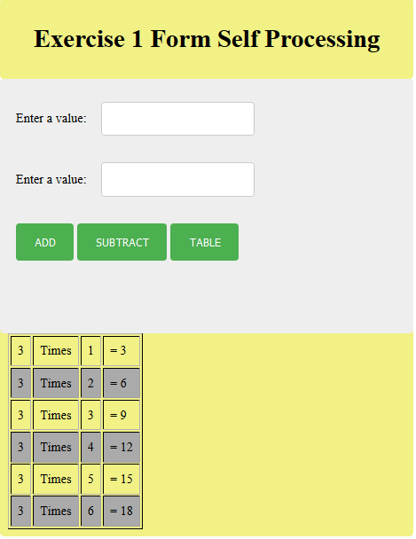
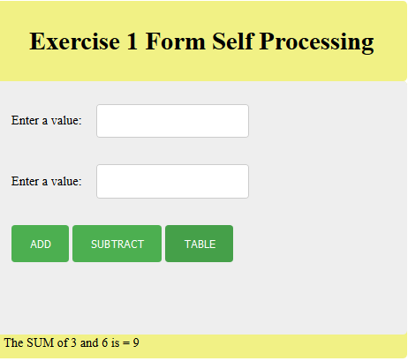
Try designing/adding some css of your own

Slide 17
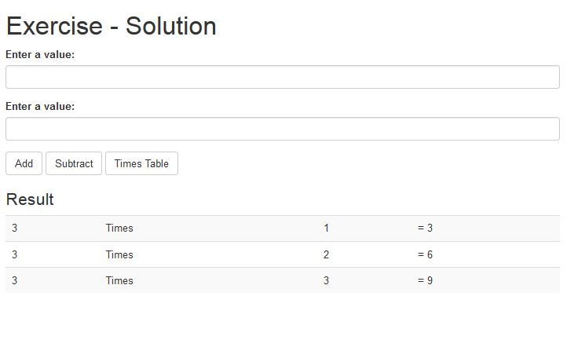
Or use twitter bootstrap

